Slide 1
Week 8
Team daea

Slide 2
Wrapper
Python code wrapper around voice separation model
Model has ConvTasNet architecture trained and implemented through the Asteroid API
The model the wrapper is based off of will be changed out to ours once developed
Wrapper:
Passes in audio with two speakers
Separates audio into two streams
Passes individual streams through noise reducer
Normalizes volume between all three voice clips

Slide 3
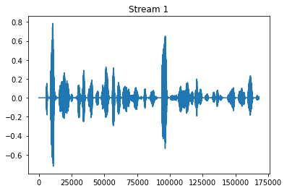

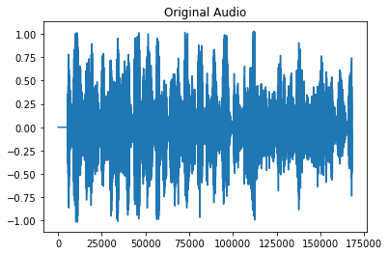
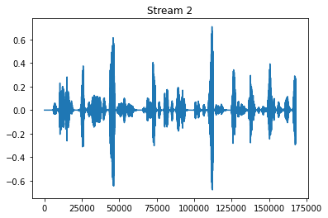
Wrapper Demo
Wrapper around Voice Separation Model

Slide 4
Improve on the Wrapper
Developing a custom data loader to train the model to work by separating out one voice at a time
The trainer will make it so each model made will be trained to separate one known person which will be trained with an audio profile
We are currently facing resource issues (hardware limitations) where we can’t even open the model to begin training

Slide 5
Google Coral Dev Board
Set up the dev board with lots of hurdles
Still unable to get python 3.9 installed on the dev board
This means we can’t try our wrapper on it
Ran a python script that recorded audio with the on-board microphone
This audio is saved as a .wav and can be played back from the dev board directly
Working on getting the wav file out of the dev board environment

